Slide 1

HOW THE WEATHER AFFECTS AND CHANGES OVER TIME
DENZEL SEE(2222840)

Slide 2
Datasets used
https://data.gov.sg/dataset/surface-air-temperature-monthly-mean?view_id=23448019-64b0-4548-afef-ad41c73bd6ae&resource_id=07654ce7-f97f-49c9-81c6-bd41beba4e96
https://data.gov.sg/dataset/historical-24-hr-psi
https://data.gov.sg/dataset/rainfall-monthly-total

Slide 3
Nature of the Datasets

Slide 4
Rainfall Monthly Total
This dataset contains the:
Month
The total rainfall

Slide 5
Surface air temperature monthly mean
This dataset contains the:
Month
Mean surface air temperature

Slide 6
Historical 24hr PSI
This dataset contains the:
Hourly measurement
Region (eg: North, South etc.)

Slide 7
Process & Insights

Slide 8
Rainfall monthly total
Process:
Filtered out the outliers and missing values
Filtered data to get 2012 and 2022 using the query function
Dropped index of new 2022 using reset index function
Line graph to:
Show the trend of monthly total rainfall in Singapore
Show the change of rainfall pattern over 10 years

Slide 9
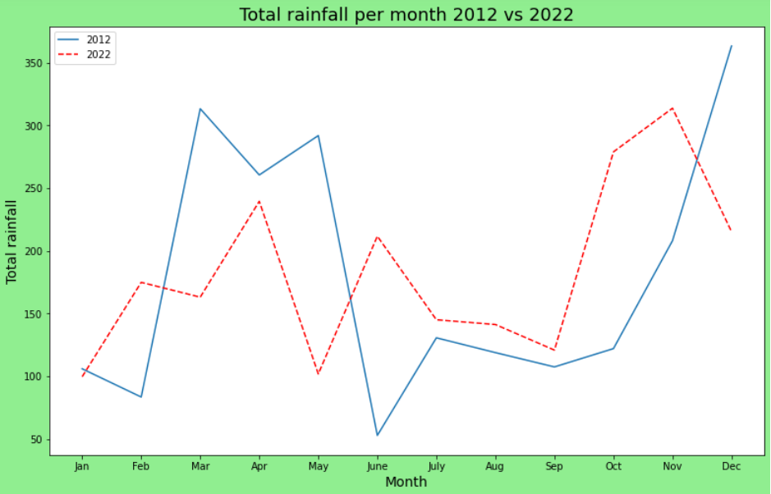
Insights
Trend of rainfall has drastically changed after 10 years
Most months that have usually more rainfall are dryer and vice versa

Slide 10
Surface air temperature monthly mean
Process:
Filtered out the outliers and missing values
Filtered data to get 2012 and 2022 using the loc function
Plot a grouped bar chart
Bar graph to:
Show the comparison between the two years
Show degree of change after 10 years

Slide 11
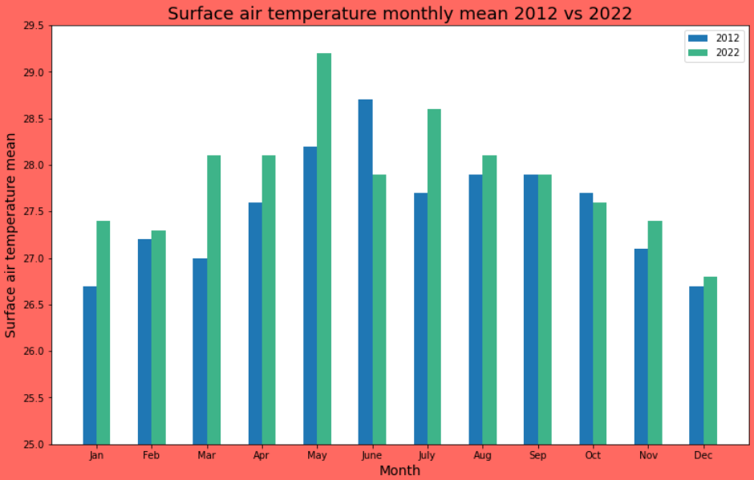
Insights
Surface air temperature has generally increase after 10 years
Biggest change in temperature occurs in March of about 1.5°C which is significant when it comes to temperature

Slide 12
Historical 24hr PSI
Process:
Filtered out the outliers and missing values
Filtered data to get two periods of 3 years using the loc function
Made new data frames and meaned new values in the process
Pie graph to:
Show the comparison the different regions
Find out if the distribution has changed over the years

Slide 13
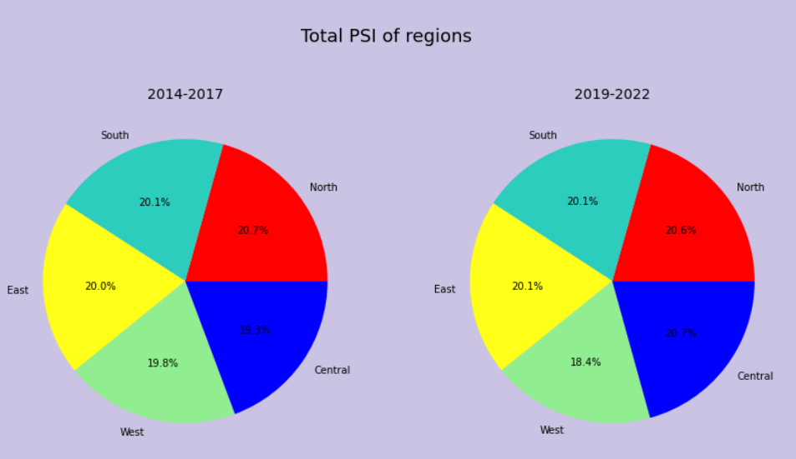
Insights
Pollution in the air is generally spread evenly among the 5 regions
The distribution in pollution between regions did not change much when comparing the periods

Slide 14
Rainfall monthly total & 24 hr PSI
Process:
Filtered out the outliers and missing values
Used resample and mean function to convert hourly data into monthly
Further average out values of region through mean(axis=1)
Filter rainfall data so that month align with PSI data using loc function
Scatter graph to:
Find out if rainfall affects PSI

Slide 15
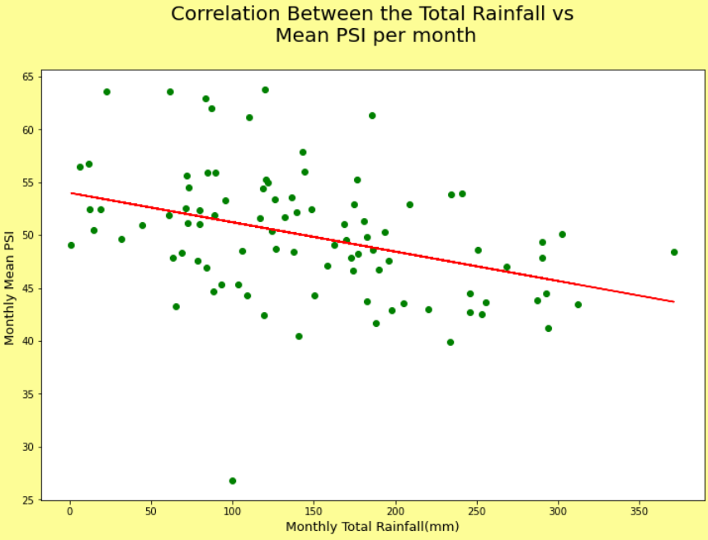
Insights
Rainfall and PSI have a negative linear relationship
The higher the rainfall the lower the PSI
This shows that rainfall directly affects PSI

